Slide 1
SEMICONDUCTORS FERMI DIRAC DISTRIBUTION
BY:
DIYA DINESH
E0321057

Slide 2
INDEX
INTRODUCTION
AIM
FORMULA
CODE AND OUTPUT
OBSERVATIONS
APPLICATIONS
CONCLUSION

Slide 3

TABLE OF CONTENTS
01
02
03
INTRODUCTION
AIM
FORMULA
04
05
CODE AND OUTPUT
APPLICATIONS
Definition and the most basic type of diode
The idea which the experiment is set to achieve.
To find the probabilitry of an electron in E
06
CONCLUSION
The judgement reached by reasoning
The python code that runs the experiment and its outp
The applications of the given topic

Slide 4
INTRODUCTION
A diode is a two-terminal semiconductor device that allows current to flow through in one direction only. It basically has negligible resistance on one end and high resistance on another to prevent the current from flowing through both ways. Thus, a diode is like a valve in an electrical circuit.
The Fermi-Dirac distribution applies to fermions, particles with half-integer spin which must obey the Pauli’s exclusion principle. Each type of distribution function has a normalization term multiplying the exponential in the denominator which may be temperature dependent.
Note: Pauli's Exclusion Principle states that no two electrons in the same atom can have identical values for all four of their quantum numbers.

Slide 5
AIM
To visualize a static plot of fermi Dirac distribution data which describes the occupancy of electrons in solids.

Slide 6
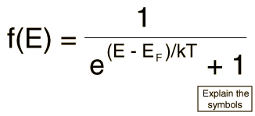
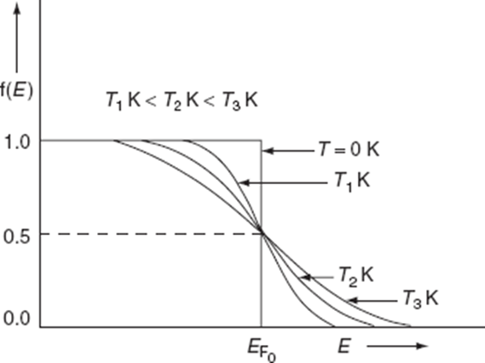
FORMULA
Where, f(E) = Probability of electron in energy level E EF = Fermi energy on fermi level k = Boltzmann’s constant = 8.6 × 10^-5 eV/k T = Absolute temperature

Slide 7
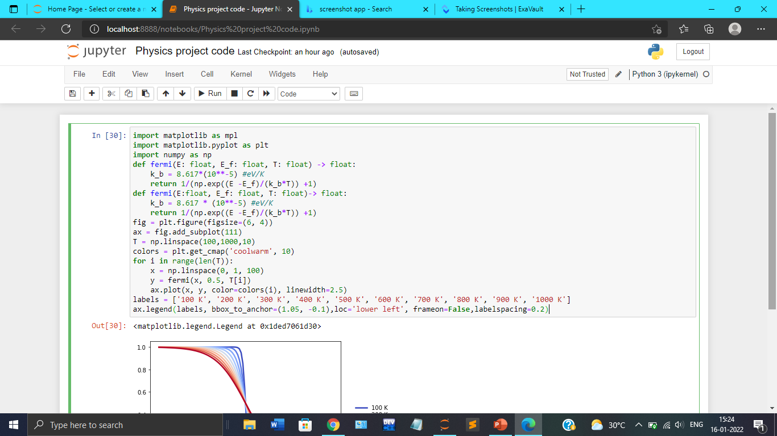
CODE

Slide 8
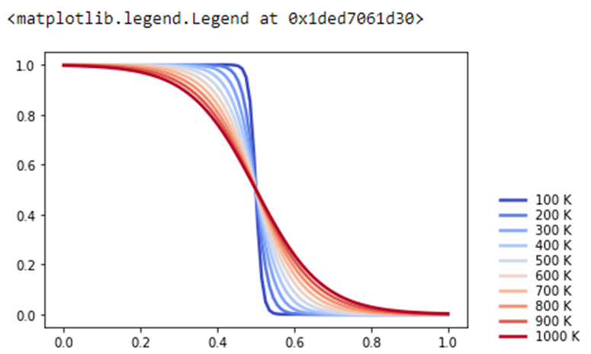
OUTPUT

Slide 9
APPLICATIONS
The Fermi function is a probability distribution function. It can only be used under equilibrium conditions. The Fermi function determines the probability that an energy state (E) is filled with an electron when the material we are working with is under equilibrium conditions.
Used in studying electrical and thermal conductivities, thermoelectricity, thermionic and photoelectric effects, specific heat of metals, etc. on the assumption that metals contain free electrons constituting like a perfect gas known as electron gas.
One can apply the Fermi Dirac distribution to any system of Fermions in equilibrium and predict macroscopic properties of such systems.

Slide 10
CONCLUSION
When the temperature(T) = 0k and E<EF, the probability of the energy level is 1.
When the temperature(T) = 0k and E>EF, then the probability of the energy level is 1.
When solids are in elec­tri­cal con­tact and in ther­mal equi­lib­rium, their (elec­tro)chem­i­cal po­ten­tials / Fermi lev­els line up.
Be­cause of the small num­ber of elec­trons in­volved, the ef­fect on the heat ca­pac­ity can usu­ally be ig­nored.

Slide 11
THANK YOU

